Slide 1
Studies of the dGCS1 Protein in Drosophila Fertilization
Victoria Garcia
Wakimoto Lab
Developmental Biology Training Grant Retreat
April 30, 2011

Slide 2
How is gamete plasma membrane interaction mediated during fertilization?
Plasma membrane fusion
Drosophila
Mammals and echinoderms

Slide 3
How is gamete plasma membrane interaction mediated during fertilization?
Plasma membrane fusion
Drosophila
Plasma membrane breakdown (PMBD)
after egg entry
Mammals and echinoderms
What is the molecular basis of these mechanisms?
Are any key molecules shared?

Slide 4
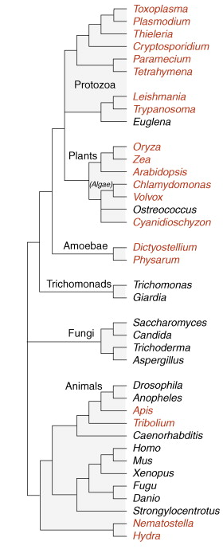
Generative Cell Specific 1 (GCS1)
Plasmodium:
Gamete fusion
Broadly distributed across
the eukaryotes
Conserved general
function in male gametes
Chlamydomonas:
Gamete fusion
Arabidopsis:
Pollen tube guidance and
gamete fusion
Does a GCS1 ortholog exist in Drosophila?
Drosophila
Apis
Tribolium
Wong JL, Johnson MA. Is HAP2-GCS1 an ancestral gamete fusogen? Trends in Cell Biology 2010;20:134-41.

Slide 5
GCS1’s Canonical Domains
Signal sequence
GCS1
TMD
Conserved cysteines
 | A. thaliana | P. bergerii
Mori, 2010: essential domains
Does a Drosophila protein with these features exist?
Yes, encoded by CG34027.
Is CG34027’s protein the Drosophila ortholog of GCS1?

Slide 6
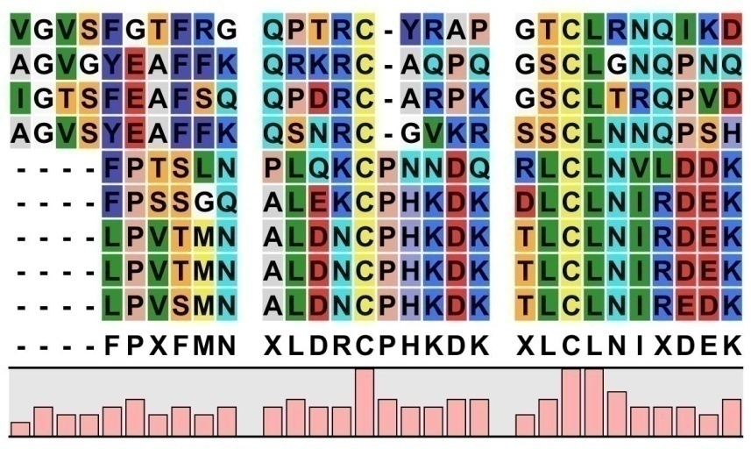
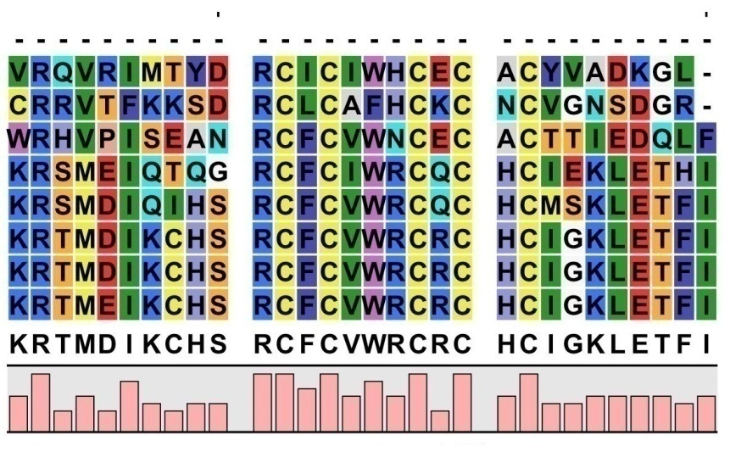
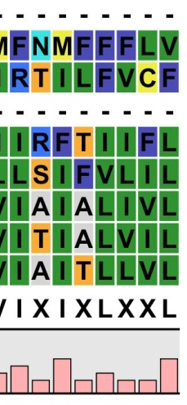
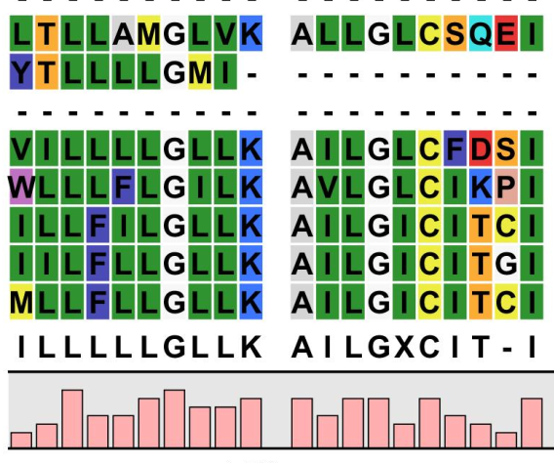
GCS1-HAP2 domain consensus sequence
(Pf10699)………….……..…
T. castaneum ………….…..
P. humanus-………….………..
A. pisum…………………………
D. willistoni …………….…....
D. ananassae …………………
D. melanogaster ………..….
D. sechellia……………………..
D. erecta………………..……….
Evidence:
CG34027p as the Drosophila GCS1
mRNA expression profile:
GCS1D
TMD
Highly enriched in the testis.
Cys-rich

Slide 7
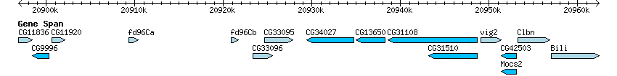
Drosophila GCS1 rescues fertility of male-sterile mutants
Allele: | Relative fertility:
pskl⁺ | 1.00
pskl^{Z3-3007,} ^{Z3-3059,} ^{Z3-3119} | ~0.03
pskl^{Z3-3007} + transgene | 1.36
pskl^{Z3-3059} + transgene | 0.88
pskl^{Z3-3119} + transgene | 1.08
What is dGCS1p’s function in Drosophila?

Slide 8
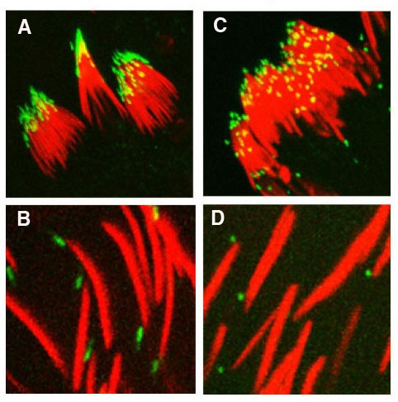
Mutants with Disrupted Acrosomes:
dGCS1 and others
Wild type
dGCS1^{Z3-3059}
agho
  No acrosome
kugi
  Absent or reduced acrosome
snky
  Lacks an acrosomal membrane protein
mfr
  Lacks an acrosomal membrane protein
Acrosome activity in mammals:
DAPI – sperm nuclei
SNKY-GFP -- acrosomes
Image by K. Wilson, Wakimoto lab

Slide 9


Mutants with Disrupted Acrosomes:
dGCS1 and others
Wild type
dGCS1^{Z3-3059}
agho
  No acrosome
kugi
  Absent or reduced acrosome
snky
  Lacks an acrosomal membrane protein
mfr
  Lacks an acrosomal membrane protein
Acrosome activity in mammals:
DAPI – sperm nuclei
SNKY-GFP -- acrosomes
Image by K. Wilson, Wakimoto lab

Slide 10
Mutants with Disrupted Acrosomes:
dGCS1 and others
Wild type
dGCS1^{Z3-3059}
agho
  No acrosome
kugi
  Absent or reduced acrosome
snky
  Lacks an acrosomal membrane protein
mfr
  Lacks an acrosomal membrane protein
Acrosome activity in
Drosophila:
DAPI – sperm nuclei
SNKY-GFP -- acrosomes
Image by K. Wilson, Wakimoto lab

Slide 11
Mutants with Disrupted Acrosomes:
dGCS1 and others
Wild type
dGCS1^{Z3-3059}
agho
  No acrosome
kugi
  Absent or reduced acrosome
snky
  Lacks an acrosomal membrane protein
mfr
  Lacks an acrosomal membrane protein
Acrosome activity in
Drosophila:
DAPI – sperm nuclei
SNKY-GFP -- acrosomes
Image by K. Wilson, Wakimoto lab

Slide 12
Mutants with Disrupted Acrosomes:
dGCS1 and others
Wild type
dGCS1^{Z3-3059}
agho
  No acrosome
kugi
  Absent or reduced acrosome
snky
  Lacks an acrosomal membrane protein
mfr
  Lacks an acrosomal membrane protein
All fail at PMBD
Acrosome activity in
Drosophila:
DAPI – sperm nuclei
SNKY-GFP -- acrosomes
Image by K. Wilson, Wakimoto lab

Slide 13
Hypotheses about dGCS1p’s role in fertilization in Drosophila:
Indirect action: Only active in spermiogenesis, during acrosome biogenesis.
SPECIFIC AIMS:
A) Identify the structure of the wild type
dGCS1 gene and its mutant alleles.
B) Characterize effects of mutations on
acrosome biogenesis, sperm morphology,
and function.

Slide 14
How is Acrosome Biogenesis Disrupted in dGCS1 sperm?

Slide 15


Slide 16
Hypotheses about dGCS1p’s role in fertilization in Drosophila:
2) Direct action: dGCS1p is present in mature sperm and acts in PMBD.
SPECIFIC AIMS:
Determine subcellular localization
D) Define functional domains

Slide 17
CONCLUSION
Studies of dGCS1 will:
Clarify a fundamental fertilization mechanism
Enhance understanding of plasma membrane
dynamics

Slide 18
Thanks to:
Barbara Wakimoto
Kathleen Wilson
Eunice Zhang
Emily Jones
Lydia Smith
Funding Sources:
-- University of Washington
-- NSF

